Slide 1
CARDIAC CHAMBERS HYPERTROPHY, CHAMBERS ENLARGEMENT AND LOW VOLTAGE ECG
BY
MR. UMAR AMINU IBRAHIM
09TH JULY.

Slide 2
TABLE OF CONTENTS
• Definition
• Types of Hypertrophy
i. Left Ventricular Hypertrophy (LVH)
- Causes of LVH
- ECG diagnostic criteria
- Examples
ii. Right Ventricular Hypertrophy (RVH)
- Causes of RVH
- ECG diagnostic criteria
- Examples
• LOW VOLTAGE
- Causes of low voltage
- Electrical alternas

Slide 3
DEFINITION
Cardiac hypertrophy is the heart's response to a variety of extrinsic and intrinsic stimuli that impose increased biomechanical stress.( Frey and Olson,2023)
Cardiac hypertrophy is an adaptive response to pressure or volume stress, mutations of sarcomere.
Ventricular hypertrophy (VH) is thickening of the walls of a ventricle (lower chamber) of the heart.

Slide 4
LEFT VENTRICULAR HYPERTROPHY
Left ventricular hypertrophy (LVH) is a condition in which there is an increase in left ventricular mass.
The left ventricle hypertrophy occurs in response to pressure overload secondary to conditions such as aortic stenosis and hypertension. This results in increased R wave amplitude in the left-sided ECG leads (I, aVL and V4-6) and increased S wave depth in the right-sided leads (III, aVR, V1-3).
The left ventricular wall thickening occurs in response to pressure overload, and chamber dilatation occurs in response to the volume overload. (Cuspidi C, et al., 2012).

Slide 5
The thickened LV wall leads to prolonged depolarisation (increased R wave peak time) and delayed repolarisation (ST and T-wave abnormalities) in the lateral leads.
ECG Diagnostic criteria
There are numerous voltage criteria for diagnosing LVH, summarised below;
The most commonly used are the Sokolow-Lyon criteria: S wave depth in V1 + tallest R wave height in V5 or V6 > 35 mm — Confirmed LVH.
There are additional criteria's for LVH such as Cornell voltage and Framingham criteria's etc.

Slide 6
However, the voltage criteria must be accompanied by non-voltage criteria to be considered diagnostic of LVH
Non Voltage Criteria
• Increased R wave peak time > 50 ms in leads V5 or V6.
• ST segment depression and T wave inversion in the left-sided leads: AKA the left ventricular ‘strain’ pattern.
Left sided leads are V5 & V6.

Slide 7
Moreover, there are many as many voltage criteria to diagnose LVH but we will stick to this ones for now.
Beause there are limb leads criteria and precordial leads criteria as well. Most commonly used is precordial leads criteria (sokolow lyon criteria).
However, you can apply Cornell or Framingham criteria's.

Slide 8
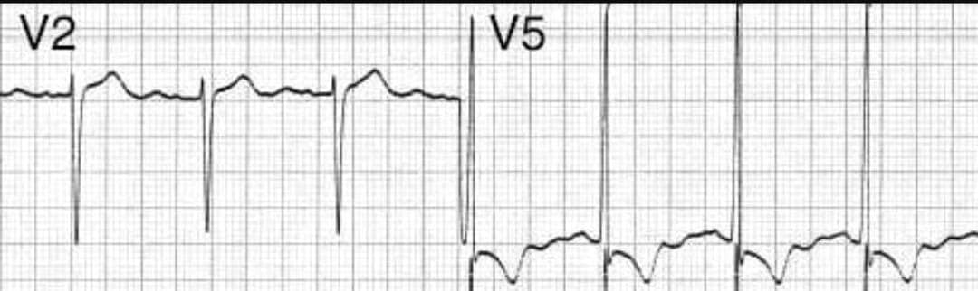
Case 1. 47yo male presented with BP:190/140mmHg and history of Hypertension for 5yrs. What's the ECG findings ?
For sokolow Lyon criteria, here, we can use deep S wave in V2 and tall R wave in V5 value greater than 35 mm is considered LVH.

Slide 9
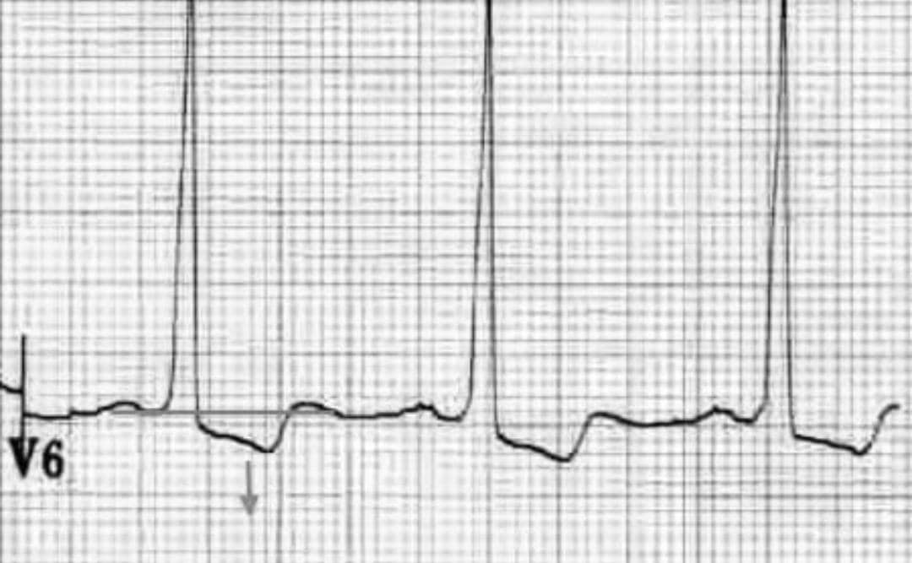
LEFT VENTRICULAR STRAIN PATTERN
This is what we called LV Strain pattern (also known as the non voltage ECG criteria for LVH), which means ST depression and T wave inversion.

Slide 10
NOTE, You have to see LV strain pattern in lateral wall leads I, aVL, V5-6 for it to be considered LVH. No strain pattern no LVH just a barely high voltage.

Slide 11
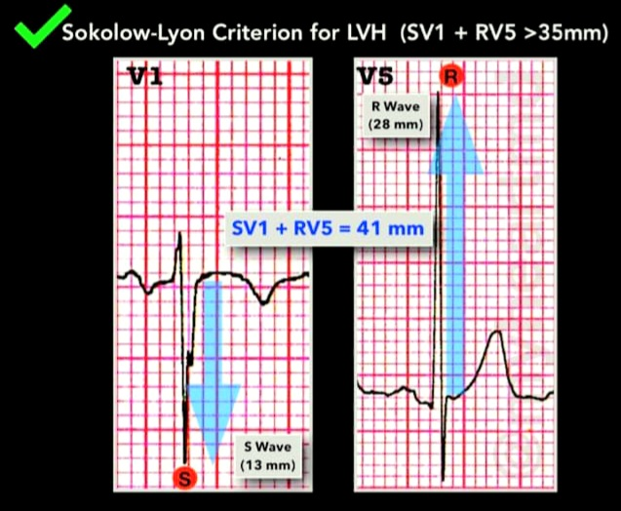

Slide 12
Additional ECG changes seen in LVH
1. Left atrial enlargement
2. Left axis deviation
3. ST elevation in the right precordial leads V1-3 (“discordant” to the deep S waves)
4. Prominent U waves (proportional to increased QRS amplitude)

Slide 13
CAUSES OF LVH
The most common cause of left Ventricular Hypertrophy is Hypertension, among other causes including;
1. Hypertension (most common cause)
2. Aortic stenosis
3. Aortic regurgitation
4. Mitral regurgitation
5. Coarctation of the aorta
6. Hypertrophic cardiomyopathy

Slide 14
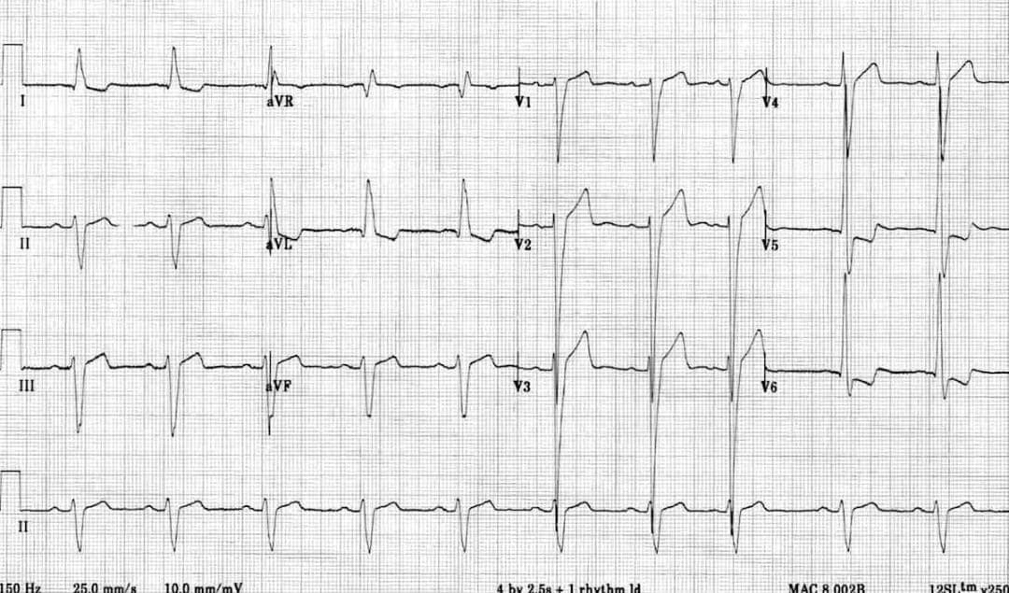
LVH from 12 leads views

Slide 15
Using a sokolow Lyon criteria
• Here, we have count numbers of small boxes in deep S wave about 19 in V1 and tall R wave in V6 about 23 = 19 + 23 = 42mm
• ST elevation through V1-V3 due to LVH
• Poor R wave progression (Loss of R wave amplitude less than 3mm in V3)
• Non voltage criteria (ST depression and T wave inversion in lateral wall leads (I, aVL, V5 & V6)
• Left axis deviation (positive QRS in lead 1 i.e upright QRS, negative deflection QRS in lead II)

Slide 16
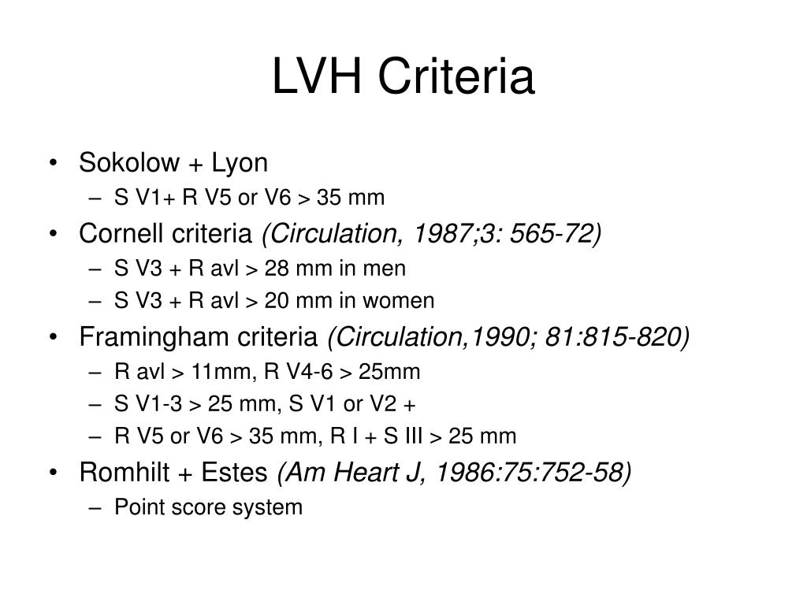
Different ECG Voltage Criteria for LVH

Slide 17
RIGHT VENTRICULAR HYPERTROPHY
The right ventriclar hypertrophy (RVH) occurs in response to pressure overload secondary to conditions such as pulmonary Hypertension/embolism, mitral stenosis and Congenital heart disease (e.g. Tetralogy of Fallot, pulmonary stenosis).
This results in increased R wave amplitude in the right-sided precordial leads (V1-V3) and increased S wave depth in the left-sided leads (V5-6).

Slide 18
Right Ventricular Hypertrophy (RVH)
Diagnostic criteria
1. Right axis deviation (lead I will be negative while lead II positive)
2. Dominant R wave in V1 (> 7mm tall or R/S ratio > 1).
3. Dominant S wave in V5 or V6 (> 7mm deep or R/S ratio < 1).
4. QRS duration < 120ms (i.e. changes not due to RBBB).

Slide 19
Supporting criteria
1. Right atrial enlargement (P pulmonale).
2. Right ventricular strain pattern = ST depression / T wave inversion in the right precordial (V1-4) and inferior (II, III, aVF) leads.
3. Deep S waves in the lateral leads (I, aVL, V5-V6).
4. Complete or incomplete RBBB may cause RVH also.

Slide 20
Causes of RVH
There are various causes of RVH these including;
1. Pulmonary hypertension
2. Mitral stenosis
3. Pulmonary embolism
4. Chronic lung disease (cor pulmonale)
5. Congenital heart disease (e.g. Tetralogy of Fallot, pulmonary stenosis)
6. Arrhythmogenic right ventricular cardiomyopathy

Slide 21
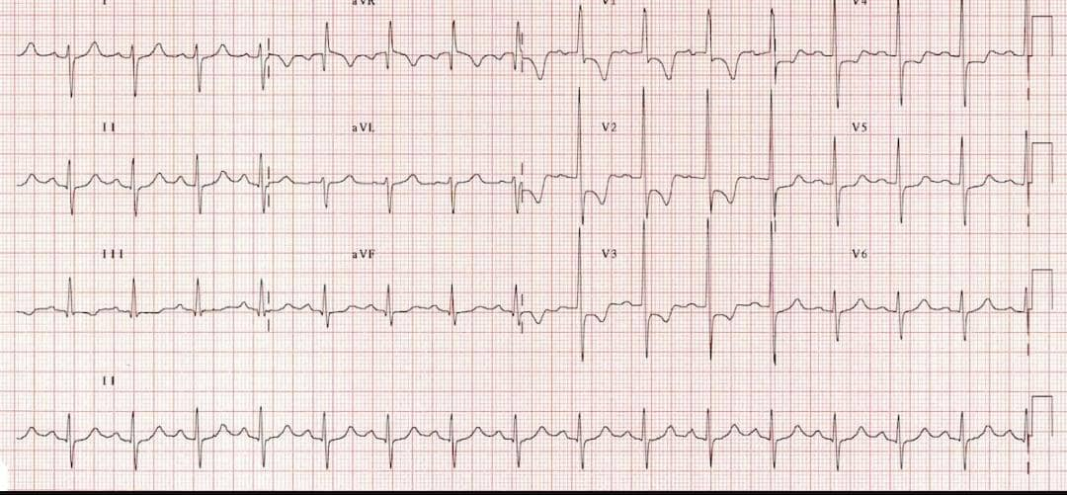
Example 1. RVH
Typical appearance of RVH with RV strain pattern

Slide 22
Step by Step interpretation of the rhythm
1. Right axis deviation (lead I is negative while lead II is positive).
2. Dominant R wave in V1 (> 7 mm tall)
3. Dominant S wave in V6 (> 7 mm deep)
4. Right ventricular strain pattern with ST depression and T wave inversion from V1-4.

Slide 23
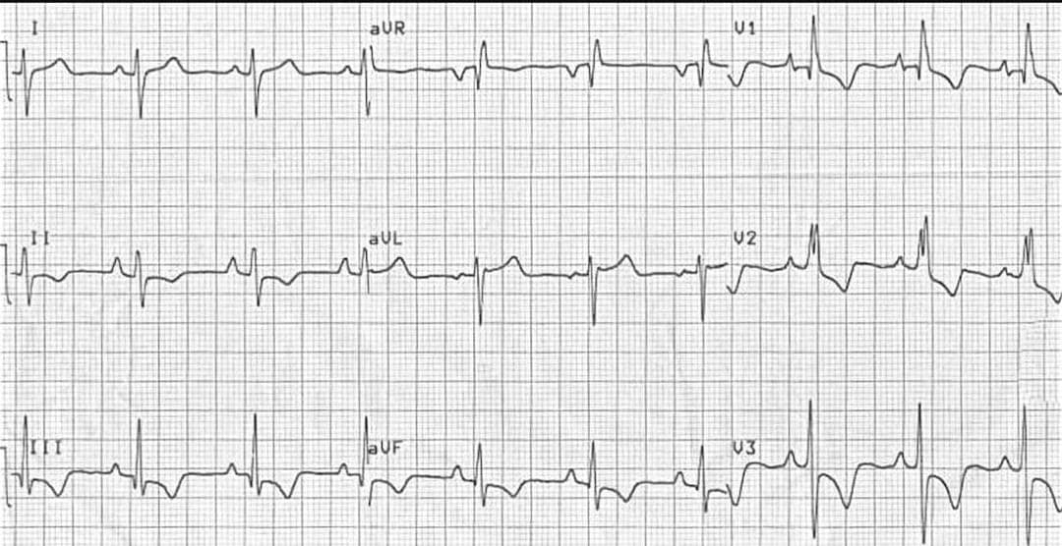
Example 2. RVH
RVH with RV strain pattern

Slide 24
Steps interpretation of the Rhythm
1. Right axis deviation
2. P pulmonale (P wave amplitude in lead II > 2.5 mm)
3. Incomplete RBBB (becos V1 is less than 3mm in duration and sR complex in V1 other than rSR' prime pattern)
4. Right ventricular strain pattern with T wave inversion and ST depression in the right precordial (V1-3) and inferior (II, III, aVF) leads.

Slide 25
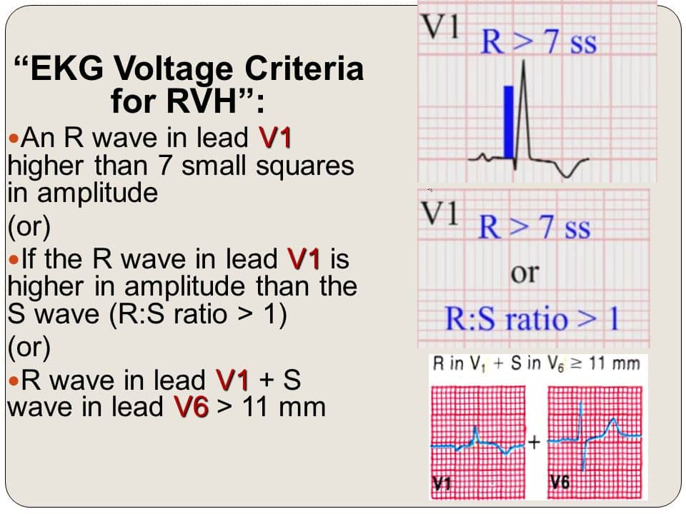
Simple RVH voltage Criteria

Slide 26
CHAMBERS ENLARGEMENT
ECG Criteria for Left Atrial Enlargement
• LAE produces a broad, bifid P wave in lead II (P mitrale) and enlarges the terminal negative portion of the P wave in V1.
In lead II
Bifid P wave with > 40 ms between the two peaks
Total P wave duration > 110 ms
In V1
Biphasic P wave with terminal negative portion > 40 ms duration
Biphasic P wave with terminal negative portion > 1mm deep

Slide 27
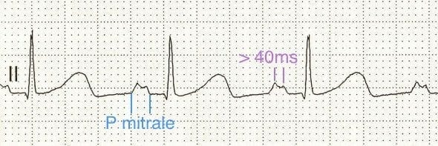
Example 1. Left atrial enlargement (LAE)
Broad (>110ms), bifid P wave in lead II (P mitrale) with > 40ms between the peaks

Slide 28
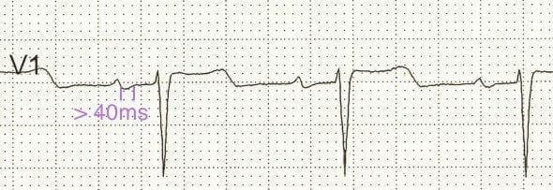
LAE CON'T
P wave terminal portion > 40 ms duration in V1

Slide 29
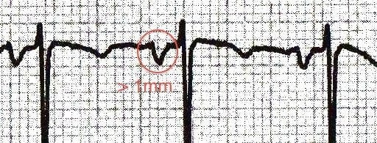
LAE CON'T
P waves with terminal portion > 1mm deep in V1

Slide 30
RIGHT ATRIAL ENLARGEMENT (RAE)
ECG Criteria of Right Atrial Enlargement
Right atrial enlargement produces a peaked P wave (P pulmonale) with amplitude:
• > 2.5 mm in the inferior leads (II, III and AVF)
• > 1.5 mm in V1 and V2
Also known as: Right Atrial Enlargement (RAE), Right atrial hypertrophy (RAH), right atrial abnormality

Slide 31
COMMON CAUSES
The principal cause is pulmonary hypertension due to:
• Chronic lung disease (cor pulmonale)
• Tricuspid stenosis
• Congenital heart disease (pulmonary stenosis, Tetralogy of Fallot)
• Primary pulmonary hypertension

Slide 32
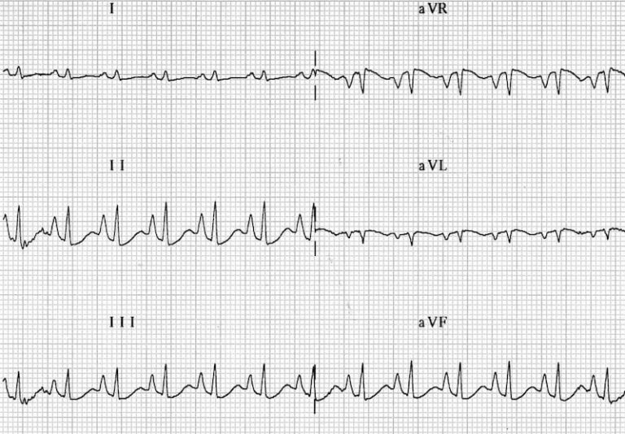
Example 1. Right atrial enlargement (RAE)
• Right atrial enlargement: P pulmonale
• P wave amplitude > 2.5mm in leads II, III and aVF

Slide 33
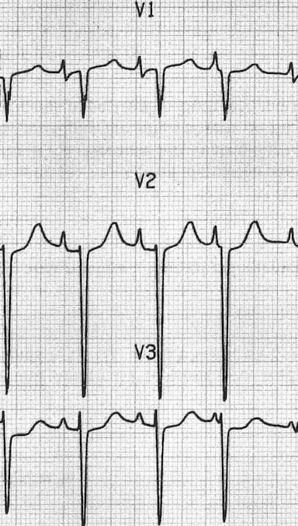
RAE CON'T
Right atrial enlargement: P wave amplitude > 1.5 mm in V1 and V2

Slide 34
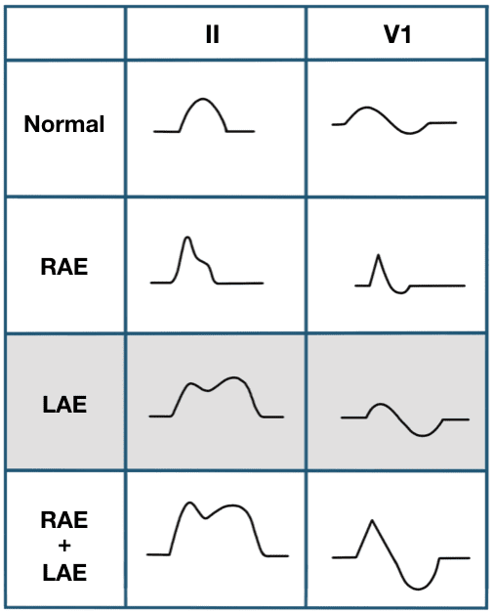

Slide 35
Low Voltage
Diagnostic Criteria
The QRS is said to be low voltage when:
The amplitudes of all the QRS complexes in the limb leads are < 5 mm; or
The amplitudes of all the QRS complexes in the precordial leads are < 10 mm.

Slide 36
Mechanisms
Low voltage is produced by:
• The “damping” effect of increased layers of fluid, fat or air between the heart and the recording electrode.
• Loss of viable myocardium
• Diffuse infiltration or myxoedematous involvement of the heart.
The most important cause is massive pericardial effusion, which produces a triad of:
Low voltage, Tachycardia and electrical alternans

Slide 37
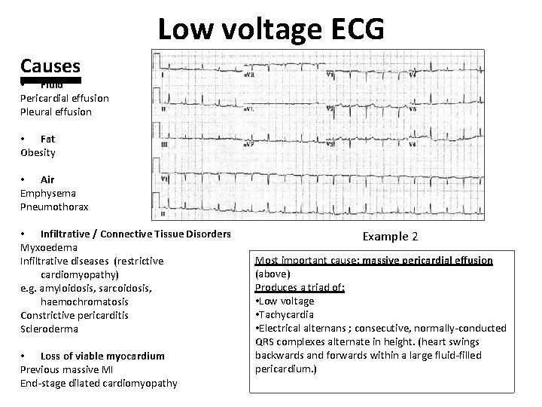

Slide 38
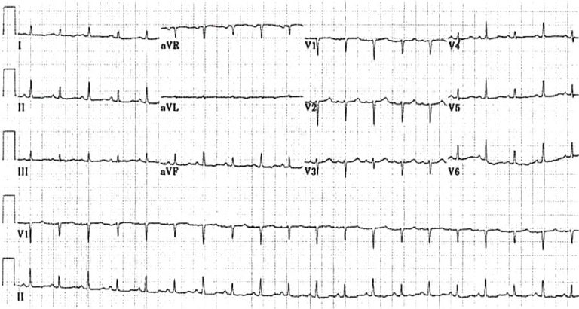
Example 1. Massive pericardial effusion
Triad of tachycardia, low voltage QRS and electrical alternans.

Slide 39
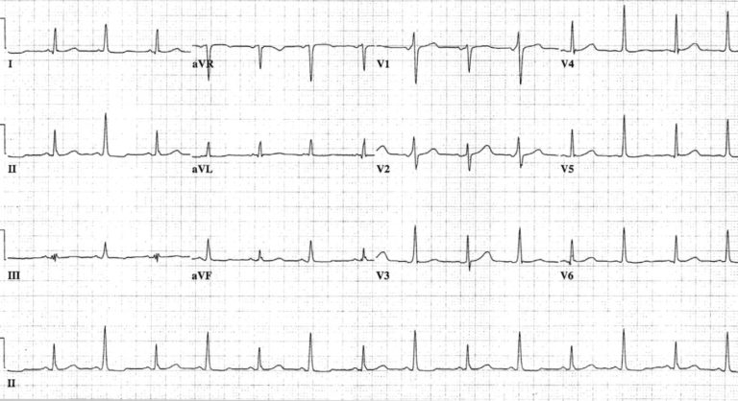
Example 3. Massive pericardial effusion
Alternating QRS amplitude and axis. Mugmon 2012

Slide 40
SEVERE HYPOTHYROIDISM
Myxoedematous deposits of gelatinous connective tissue within the myocardium.
Decreased activity of the sympathetic nervous system
Effects on the myocardium of reduced levels of thyroxine (i.e. reduced inotropy/chronotropy)

Slide 41
ECG DIAGNOSTIC CRITERIA
Severe hypothyroidism (myxoedema) causes a triad of:
• Bradycardia
• Low QRS voltage
• Widespread T-wave inversions (usually without ST deviation).
Other ECG changes that may be seen include:
QT prolongation
• First degree AV block
• Interventricular conduction delay (IVCD)

Slide 42
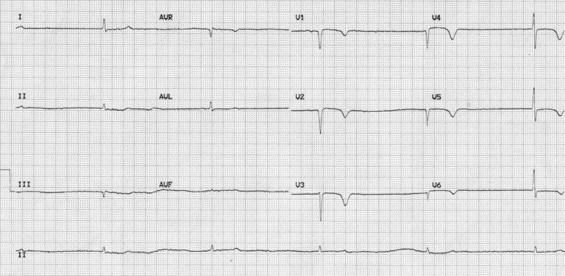
Example 4. This is the admission ECG of a 79-year old man who was referred to ICU with coma, hypothermia, severe bradycardia and hypotension refractory to inotropes.
The ECG shows marked bradycardia (30 bpm) with low QRS voltages (esp. in the limb leads) and widespread T-wave inversions, typical of severe myxoedema.

Slide 43
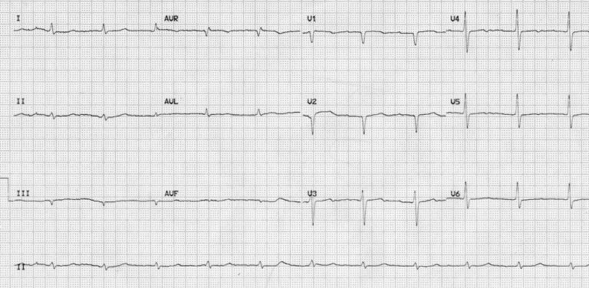
Myxoedema coma (after treatment)
An ECG of the same patient shortly after initiation of thyroid replacement with intravenous T3 and T4.

Slide 44
Note:
• The heart rate has normalised and the T-wave inversion has corrected.
• Low voltage in the limb leads persists and is likely due to myxoedematous infiltration of the myocardium.

Slide 45
THANK YOU FOR LISTENING

